Slide 1
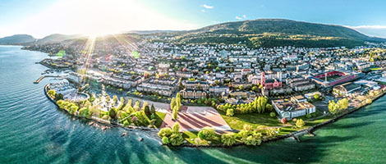

Information session:
PhD program in social work
Transdisciplinary Institute of Social Work (ITTS)
Friday December 5, 12h00-14h00 (online)
Barbara Waldis, Michaela Slotwinski & Ophélie Bidet
ITTS, Faculty of Economics, UniNE

Slide 2
Table of content
Legal base and goals of ITTS
Specificity of ITTS, team & committees
Regulation for the ITTS PhD program
ITTS PhD students, cohort September 2025
MA of the ITTS PhD students
ITTS PhD supervisors
Reasons for doing a PhD in social work
Planning and financing a PhD
9. The 7 steps to start a PhD at ITTS
10. PhD process at ITTS
11. Structure of the PhD program
12. Pedagogical agreement
13 & 14. Seminars offers 2026, spring, fall
15. Other doctoral seminars elsewhere
16. Contact

Slide 3
1. ITTS : Legal base & goals
Art. 4,2 : For the third cycle, universities and other academic institutions in the university sector offer universities of applied sciences and universities of teacher education opportunities for cooperation in a spirit of partnership. https://www.fedlex.admin.ch/eli/cc/2019/722/fr ; https://www.fedlex.admin.ch/eli/cc/2019/722/de
Regulation of the Council of Universities on the coordination of training at Swiss universities (Art. 11 Uni: BA MA, PhD; Art.12 FH: BA, MA)
Goals of the ITTS
Institute for the PhD in Social Work
Promotion of the next generation of social work 3rd cycle training
Examination of social work practice based on theoretical foundations
Contribution to the development of new knowledge by scientific studies in social work

Slide 4


2. Specificity of the ITTS PhD program, team, committees
First institute specifically and exclusively for the PhD in social work in Switzerland
Transdisciplinary perspective as PhD thesis are co-supervised by a professor of a UAS in social work and by a professor of UniNE
PhD title in social work delivered by University of Neuchâtel
(in collaboration with HES-SO and FHNW)
Open to holders of a MA of an UAS or a UNI in social work, social sciences, law and economics
PhD students are supported by a PhD programme (in English)
A collaboration of UniNE and the School of social work of the UAS Western Switzerland – and of the UAS Northwestern Switzerland starting January 1st 2025
Steering committee
Scientific committee
Team
https://www.unine.ch/itts/equipe/
https://www.unine.ch/itts

Slide 5
3. Regulation for the ITTS PhD program
PhD regulation of the Faculty of Economics and Business:
https://www.unine.ch/media/wp-content/uploads/sites/17/r_doctorat_FSE.pdf
Admission guidelines of the ITTS:
https://www.unine.ch/itts/doctorat-en-travail-social/
PhD charta of UNINE- ideas & ethics for supervision
https://www.unine.ch/media/wp-content/uploads/sites/17/UNINE_charte_doctorat_EN.pdf
https://www.unine.ch/luniversite/organisation/commissions/
Pedagogical agreement of the ITTS (see slide 14)
Notes:
Art 4: PhD committee, validation Project; Art.8-10: Defence procedure
Decisions taken by the scientific committee (minutes of the meeting)
If a PhD is codirected by a professor of another faculty than FSE, automatically an ITTS professor is part of the comité de thèse and the jury de thèse, see admission guidelines (2022-09-29)
Equivalences are only given for identical seminars, PhD level (2022-09-29)
Maximum of 6 ECTS as equivalences for the pedagogical agreement (2023-11-07)

Slide 6
4. ITTS PhD students, cohort September 2025
Roberto Cassanello, Decisionmaking in social work, Manuel Bachmann (BFH), Adrian Bangerter (UniNE)
Hafid Najwa, Migration and human rights, Lisa Borrelli (HESTS-VS), Gianni D’Amato (UniNE)
Camille Naef, Ecosocial and disaster social work, Swetha Rao Dhananka (HEFR), Antti Rajala (UniNE)
Eric Ryhiner, Socio-spatial approaches and legal regulations in youth work , Christian Reutlinger (FHNW), Sandra Hotz (UniNE)
Minnie Silfverberg, Social media for parent counseling, Olivier Steiner (FHNW), Nuria Sanchez-Mira (UniNE)
Thomas Wagner, Part-time jobs in social work, Joël Gautschi (ZHAW), Michaela Slotwinski (UniNE)
Pascal Wyssling, Professional identity of social worker, Gregor Husi (HSLU), Gianni D’Amato (UniNE)
Exhaustive list of ITTS PhD students available on
https://www.unine.ch/itts/equipe/

Slide 7
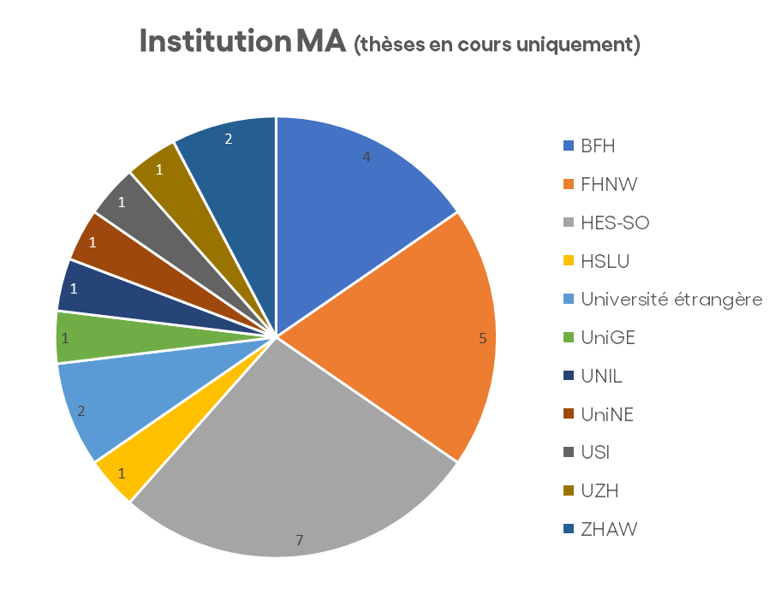
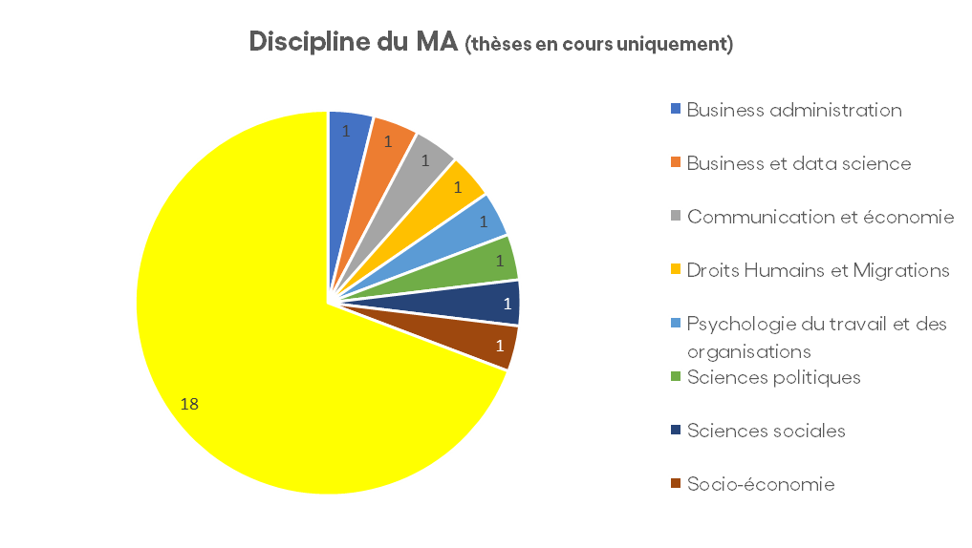
5. MA of 26 PhD students at ITTS

Slide 8
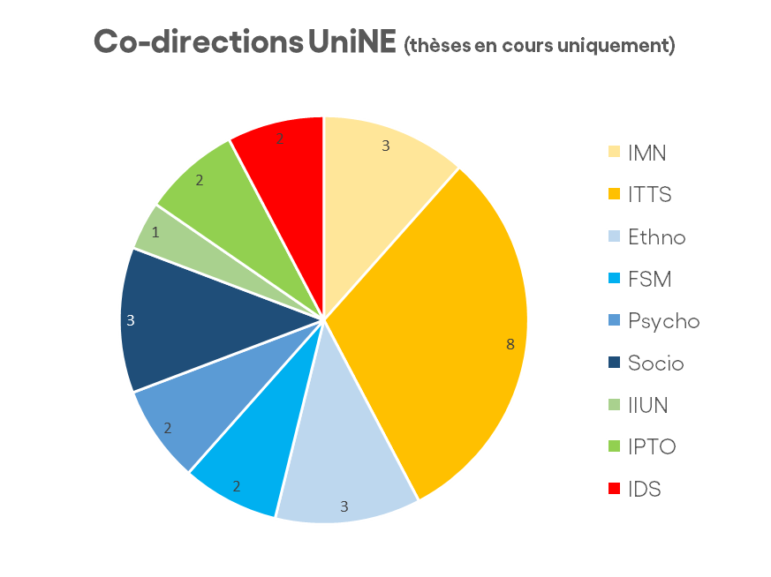
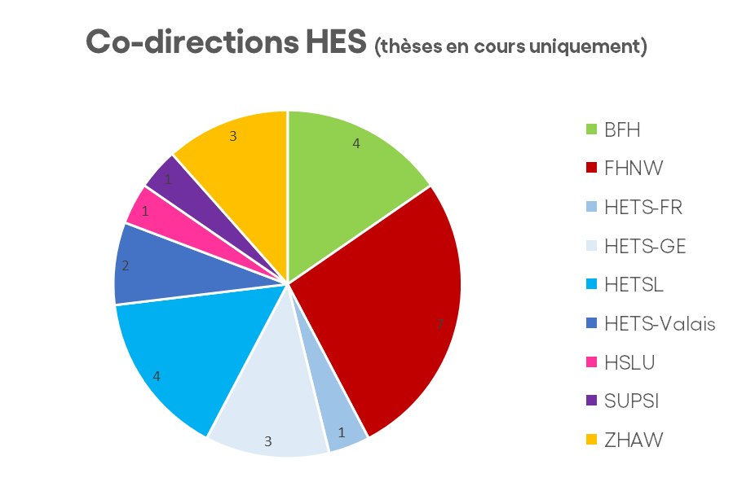
6. Co-supervisors

Slide 9
7. Reasons for doing a PhD in social work
Because you are curious and keen to achieve new, systematic, solid, empirical knowledge about a specific question on a social problem
Because you plan to pursue an academic career in the discipline of social work, do high level research, funded by science bodies, and teach future social workers at BA, MA and PhD level
Because you strife for the equal recognition of professional knowledge in the action oriented discipline of social work next to medical doctors, lawyers, psychologists and pedagogues
Because you need to demonstrate a scientifically founded positionality for an officially recognised leadership role in your institutional field of social work

Slide 10


8. Planning and financing a PhD
You need to be able to finance at least 40% time:
Participate as an SNF researcher in a project
Work as a (part-time) teaching and / or research assistant in a UAS of social work or at UNI
Work part-time in a social institution (max. 60%)
Apply for grants
You need time (at least 2 days a week)
Your planning goes over 5 years (10 semesters), limit given by the regulations of the Faculty of Economics and Business at UniNE
Do not work more than 60%

Slide 11
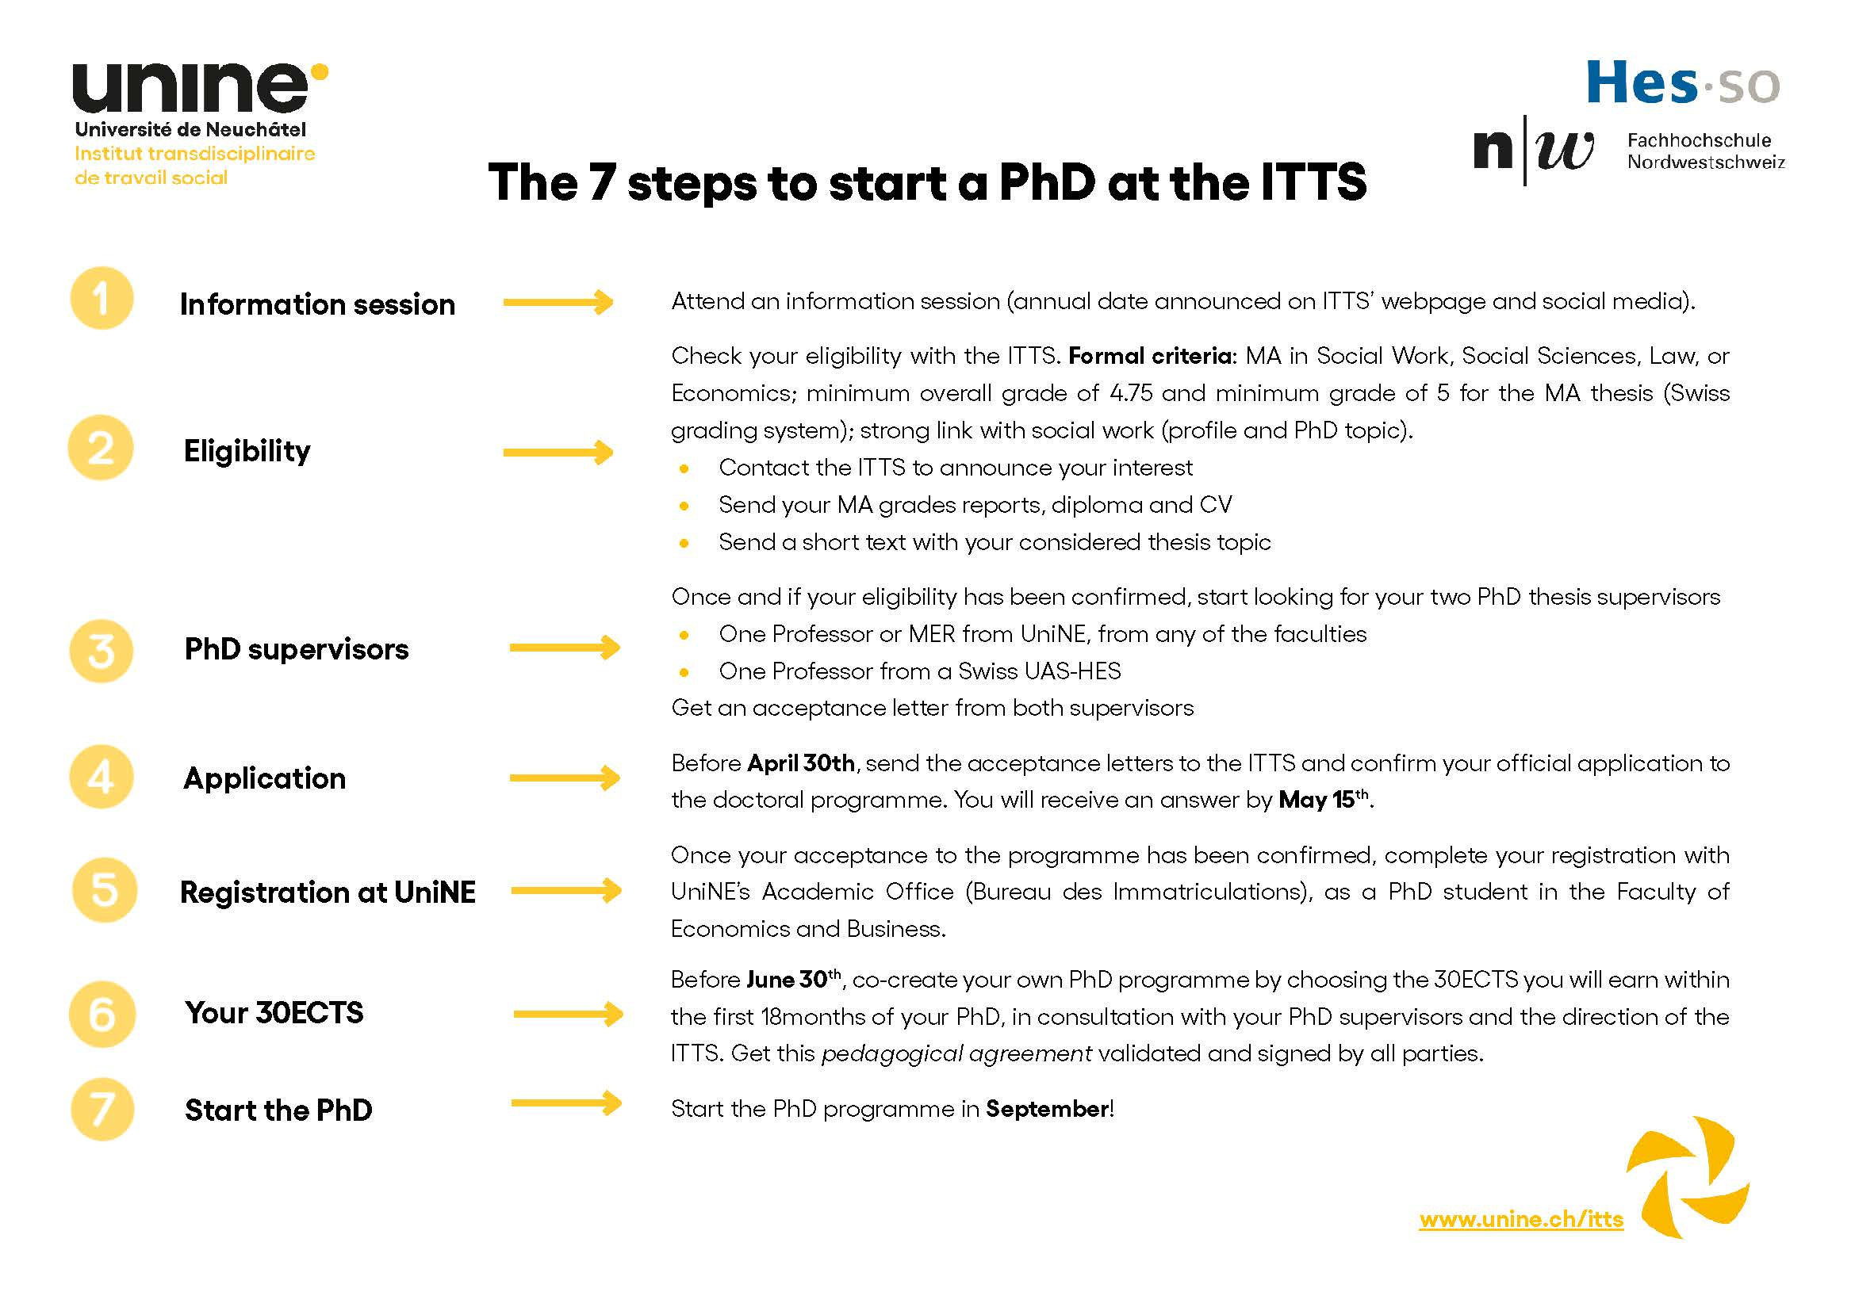

Slide 12

10. PhD process at ITTS
ITTS PhD Program/
30 ECTS of Pedagogical agreement (seminars, classes, conferences, etc) & writing the PhD project
PhD work: Individual, empirical work, analysis, presenting and discussing results, writing up the PhD (monography or articles)
Eligibility & co-direction
Application & selection
Pedagogical Agreement
Registration
Starting the PhD
Validation of PhD project
Submission of PhD & defense
Application before
April 30th
(next deadline: April 30th 2026)
Decision by May 15th
Every September (next date: September 14th 2026)
+ 18 months
+ 5 years
Once per semester: PhD colloquium
PhD title of UniNE with mention "in partnership with HES-SO & FHNW”

Slide 13
11. Structure of the PhD program
Each PhD-student must complete
30 ECTS during the first 18 months.
The PhD student decides upon its own programme, together with the two supervisors and the direction of the ITTS.
The individual programme of 30 ECTS is listed in the pedagogical agreement.
The participation in international seminars, conferences are encouraged and the ITTS / FSE support these participations financially.
30 ECTS
6+6 ECTS qualitative and quantitative methodologies
in social work
6 ECTS
of seminars in theories/ concepts of social work
6 ECTS (min)
in the PhD topic-related discipline
6 ECTS
of post graduate seminars or summer-schools
4 participations in the PHD colloquium are mandatory

Slide 14
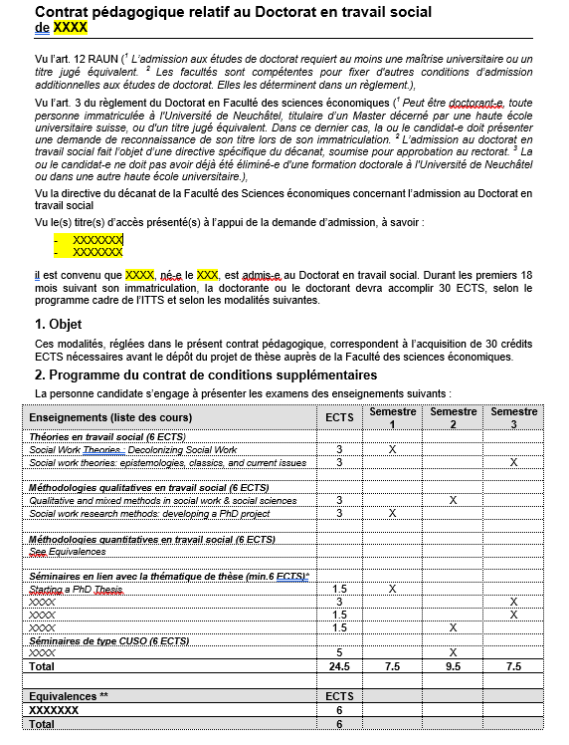
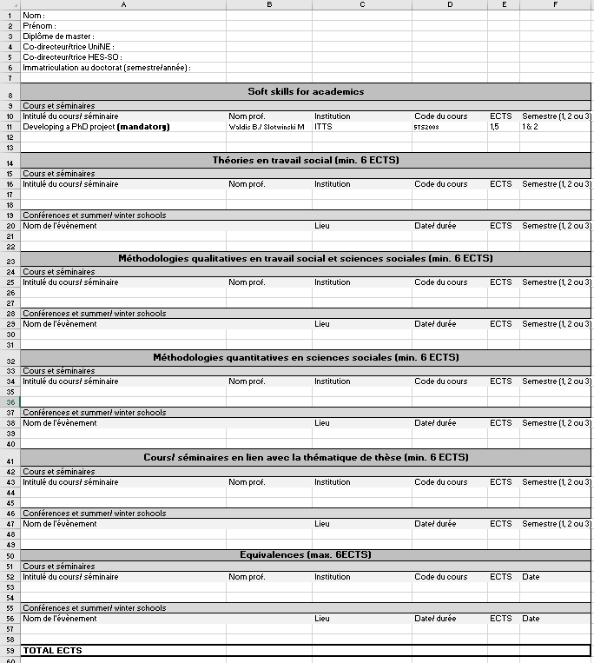
12. Pedagogical agreement

Slide 15
13. Seminars: Spring semester 2026
Seminar | Professor(s) | Credits | Dates
Soft Skills for Academia
Colloquium on academic writing | Emmanuelle Reuter | 3 ECTS | Friday 20.02.26, 13.03.26 & 24.04.26, full days
Writing Bootcamp | Mirjam Godskesen | 2 ECTS | Monday 31.08.26 to Wednesday 02.09.26, full days
Theories in Social Work
Current Issues in Social Work: State Interventions in Family and Private Life | Colleen Henry | 3 ECTS | Thursdays 21.05.26, 04.06.26 full days, Monday 22.06.26 afternoon, Tuesday 23.06.26 full day
Methodologies
Introduction to Survey (Experiment) Methods in Social Science Research | Michaela Slotwinski | 3 ECTS | Friday 06.03.26, 20.03 & 17.04, full days; Friday 29.05, morning
Qualitative and mixed methods in social work & social sciences | Colleen Henry | 3 ECTS | Thursdays 19.02.26 afternoon, 05.03.26, 02.04.26, 23.04.26 full days

Slide 16
14. Seminars: Fall semester 2026
Seminar | Professor(s) | Credits | Dates
Soft Skills for Academia
Starting a PhD thesis, entering the PhD process | Borrelli L. & Slotwinski M. | 1,5 ECTS | Thursday 17.9.26, full day; Friday 29.01.27, full day
Theories in Social Work
Social work theories: epistemologies, classics, and current issues | Borrelli L. | 3 ECTS | Thursday 22 & Friday 23.10.26, full days; Thursday 03 & Friday 04.12.26, full days
Current topical issues in social work | NN. | 3ECTS | TBD
Methodologies
Social work research methods: developing a PhD project | Borrelli L. | 3 ECTS | Thursday 01 & Friday 02.10.26, full days; Thursday 19 & Friday 20.11.26, full days
Making Sense of Data: An Introduction to Quantitative Reasoning in Social Sciences | Slotwinski M. | 3 ECTS | Friday, am: 16.10.26; 30.10.26; 13.11.26; Friday, full day: 27.11.26; 11.12.26

Slide 17





15. Other doctoral seminars elsewhere
Other possibilities: CUSO, Triangle Azur, BENEFRI & programme UNINE
https://competences.cuso.ch/en/welcome
https://www10.unine.ch/descriptifs/
Watch out for excellent (inter)national teaching offers (post graduate level) regarding your topic, your methods. Also consider presenting at (inter)national conferences gathering experts in your field. Discuss with your PhD supervisors!

Slide 18
16. In case of questions
ITTS administrative matters
Any other question (admission criteria, search for supervisors, pedagogical agreement,…)
Registration at UniNE
(in due time)
Service des
Immatriculations
immatriculation@unine.ch
messagerie.itts@unine.ch
ophelie.bidet@unine.ch

Slide 19
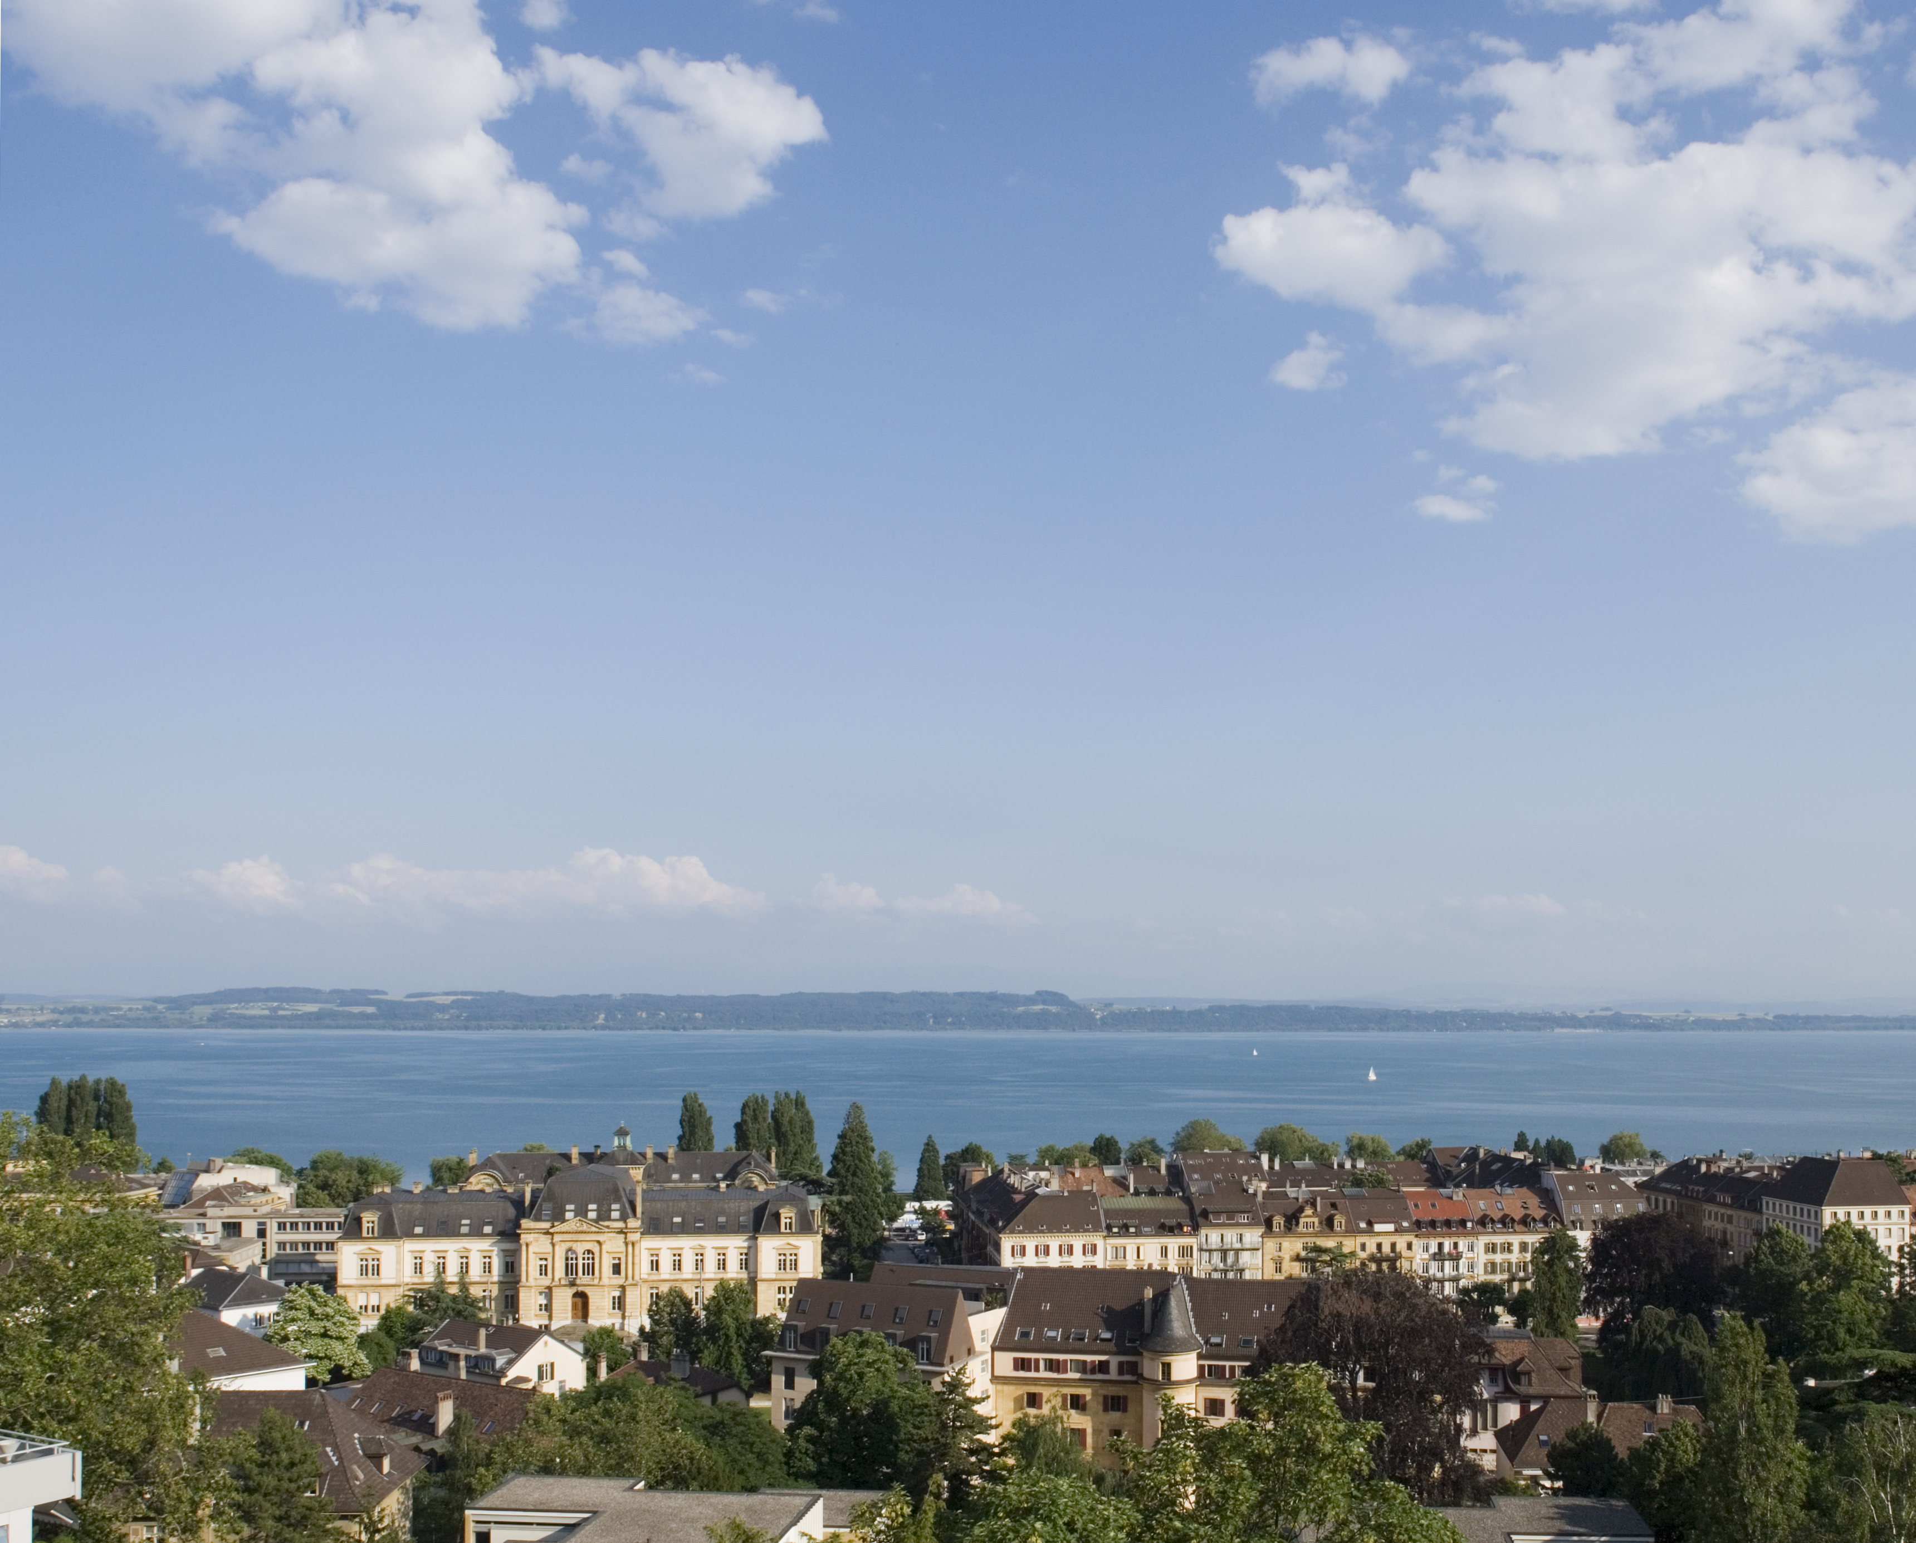
Thank you for your attention !
Questions and remarks?
Michaela Slotwinski, Assistant Professor & Co-director of ITTS
michaela.slotwinski@unine.ch
Ophélie Bidet, Responsable pédagogique
ophelie.bidet@unine.ch
Secrétariat ITTS
messagerie.itts@unine.ch
Institut transdisciplinaire de travail social (ITTS)
A.-L. Breguet 2
CH-2000 Neuchâtel

