Slide 1
Doctoral School
in
Life Sciences

Slide 2
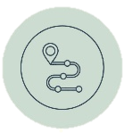
What is the DSLS?
The Doctoral School in Life Sciences (DSLS) constitutes the doctoral program of the Institute of Biology at UniNE.
What is the DSLS mission?
The DSLS has for mission to promote and foster scientific quality and integrity, to help you complement and further your education and skills,
and to ensure a satisfactory and timely progress of your PhD thesis.
Foster education
The DSLS offers a variety of workshops, courses and activities to help you complement and further your education and skills.
Monitor progress
To ensure a satisfactory and timely progress of the PhD thesis, the DSLS requires that you and your supervisor report each year on the progress your PhD thesis. This is achieved
through the annual Thesis Advisory Committee (TAC) meetings and supervision evaluation questionnaires.
Support and advise
The DSLS academic coordinator can provide advice and support on how to best promote your academic, scientific, and transversal
skills. In case of conflict or personal issues related to the PhD thesis, the coordinator can put you in contact with the service best suited to answer your questions or help you.
How to enroll in the program?
Registration to the DSLS is mandatory for all PhD candidates of the UniNE Institute of Biology. You thereby commit to the requirements of the Doctoral School. To register, you must send your registration form, accompanied by your CV, to ds.biology@unine.ch.

Slide 3
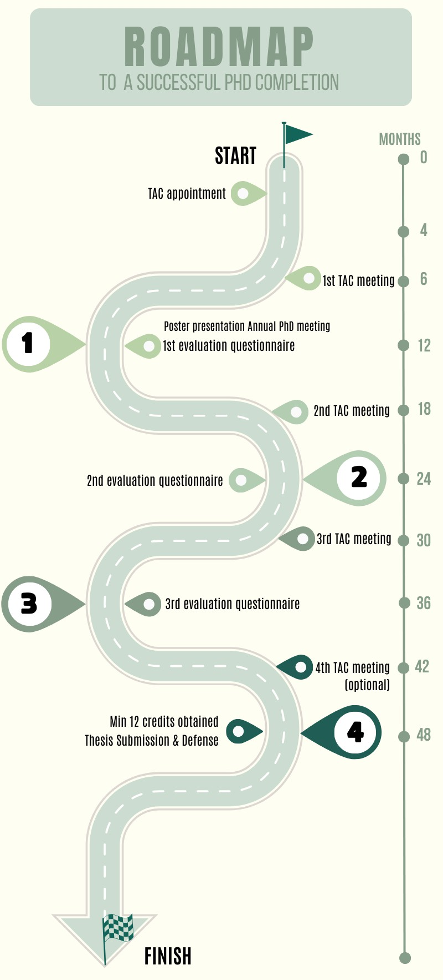

Slide 4
Does the DSLS deliver a degree?
The DSLS does not award the PhD degree. After a successful PhD defense, the DSLS delivers a certificate of completion to the candidates who have complied with all its requirements.
What are the DSLS requirements?
As a DSLS member you are required to fulfill a number of requirements during the time of your PhD:
Appoint a Thesis Advisory Committee (TAC) and organize its yearly meetings.
Validate credits by following workshops and courses.
Present a poster at the Annual PhD meeting the first year of their PhD.
What is the Thesis Advisory Committee (TAC)?
The TAC is a committee of experts whose role is to advise, support, and provide critical feedback on your thesis project and results interpretation.
Composition of the TAC
The TAC consists of at least three members (maximum five) including the PhD supervisor, one internal expert (from the PhD hosting institution) and one external expert (from an external institution). All members of the committee should hold a PhD and have expertise in the Thesis project’s research topic.
How often does the TAC meet?
The TAC meets once a year. First within the first 4 to 6 months of the PhD (ideally before the first field work or data collection) to evaluate the project feasibility and methodology. Then 18, 30, and 42 months after the onset of the PhD thesis. We encourage these meetings to be held online. You and your supervisor are responsible for organizing the meetings.
How many credits are required?
DSLS members are required to validate a minimum of 12 credits in total during the course of their PhD, with a minimum of 6 credits within the DSLS program (and a minimum of 2 credits in each credit category: Transferable skills, Research tools, and Scientific activities.)

Slide 5
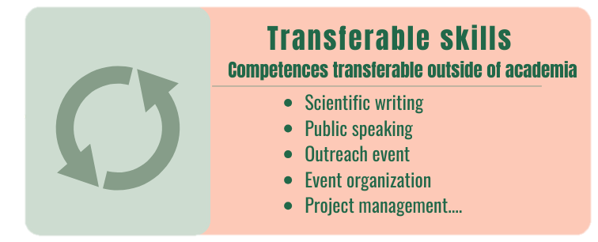
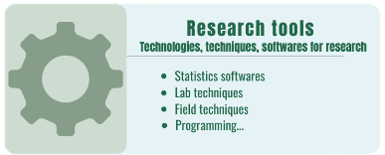
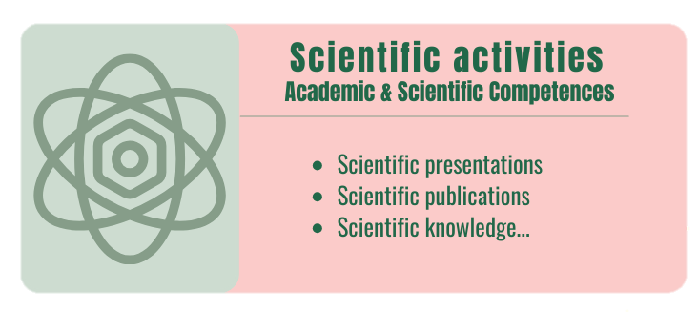
What are the 3 credit categories?
How to get credits?
Credits can be acquired by following courses, activities, and workshops organized by the DSLS or by External
programs (CUSO, Ateliers REGARDS, LS², etc.), by presenting at conferences or seminars, by publishing papers as first author, by participating in outreach activities, or by organizing events.
How to validate credits?
Credits acquired with DSLS activities are automatically validated. Credits for participation to an external activity are validated after sending a certificate of attendance and the External Credit Validation form to ds.biology@unine.ch. For oral and poster presentations, the abstract and the meeting program (mentioning the presentation) are required.
How many credits per activity?
The credit value of a given activity is at the discretion of the Doctoral School academic coordinator. However, as a rule of thumb, one day of workshop (7h), participation to an outreach event, event organization, oral presentations, and publications as first author, are all worth one credit.

Slide 6
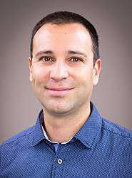
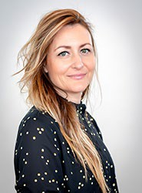
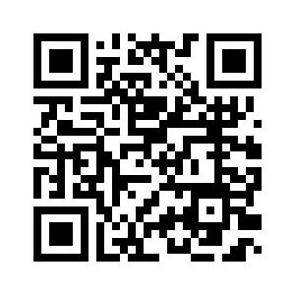
.
Who are we?
Prof. Sergio Rasmann DSLS Director sergio.rasmann@unine.ch
D225
+41 32 718 23 37
Dr Emilie Genty
DSLS Academic coordinator
ds.biology@unine.ch
D313
+41 32 718 25 02
Flor von Arx
DSLS Administrative coordinator flor.vonarx@unine.ch
D313
+41 32 718 23 24
@doctoral.school.life.sciences
Activities program

