Slide 1
Publishing options: Swiss institute associated authors

Slide 2
Key information
How do we determine eligibility of the article for the Swiss agreement?
The submission date of the article should be on or after 1st January 2020
The corresponding author must be from a participating institute
The article must be from a participating journal
2. Why do we use submission date as the eligibility criteria?
The submission date is the only stable point the publishing process. Acceptance and publication dates vary based on the journal processes
The author controls the submission date. This gives the author not just control, also transparency and predictability however long or short the journal will take for the review and publication process

Slide 3
Key information
3. Role of the institutional librarian in the Elsevier OA Platform (EOAP)
By the time the article in is your EOAP, we have published the first version of your article in Science Direct (within 48 hours of acceptance)
You therefore do not approve the publication of the article, you validate whether the corresponding author can make use of the APC fund as part of the agreement

Slide 4
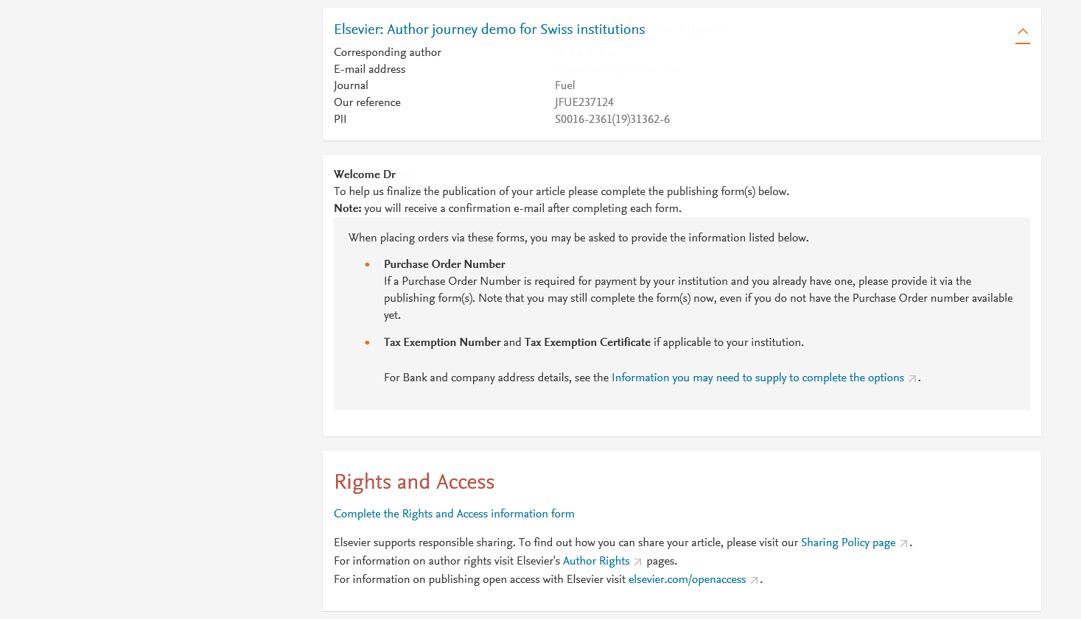
Corresponding author receives an email post acceptance with a link an unique link to complete the author journey and choose publishing options
Click on ‘Complete the Rights and Access information form’ or make changes and resubmit link in case you already completed the journey previously

Slide 5
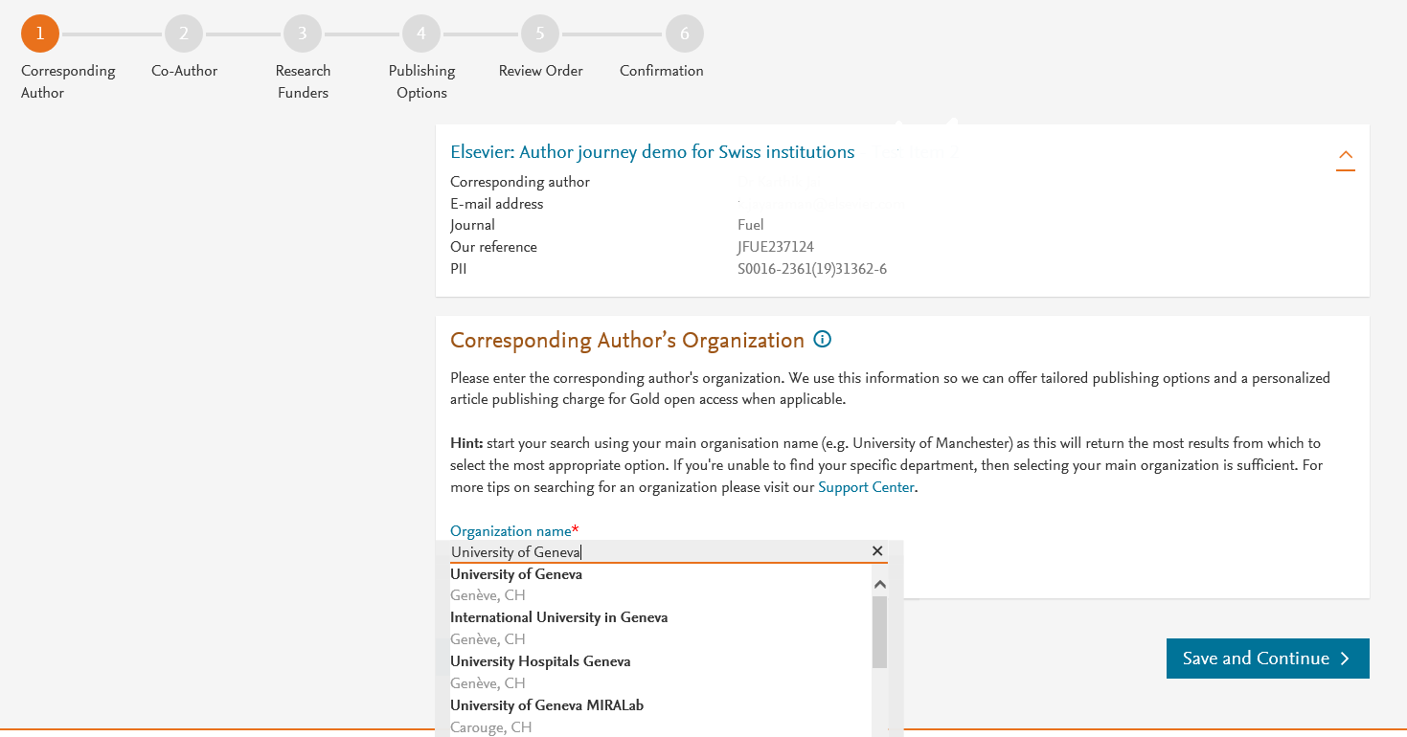
Corresponding author selects his/her affiliation details which we use to identify the authors and match them to the Swiss agreement
In this case author chooses University of Geneva

Slide 6
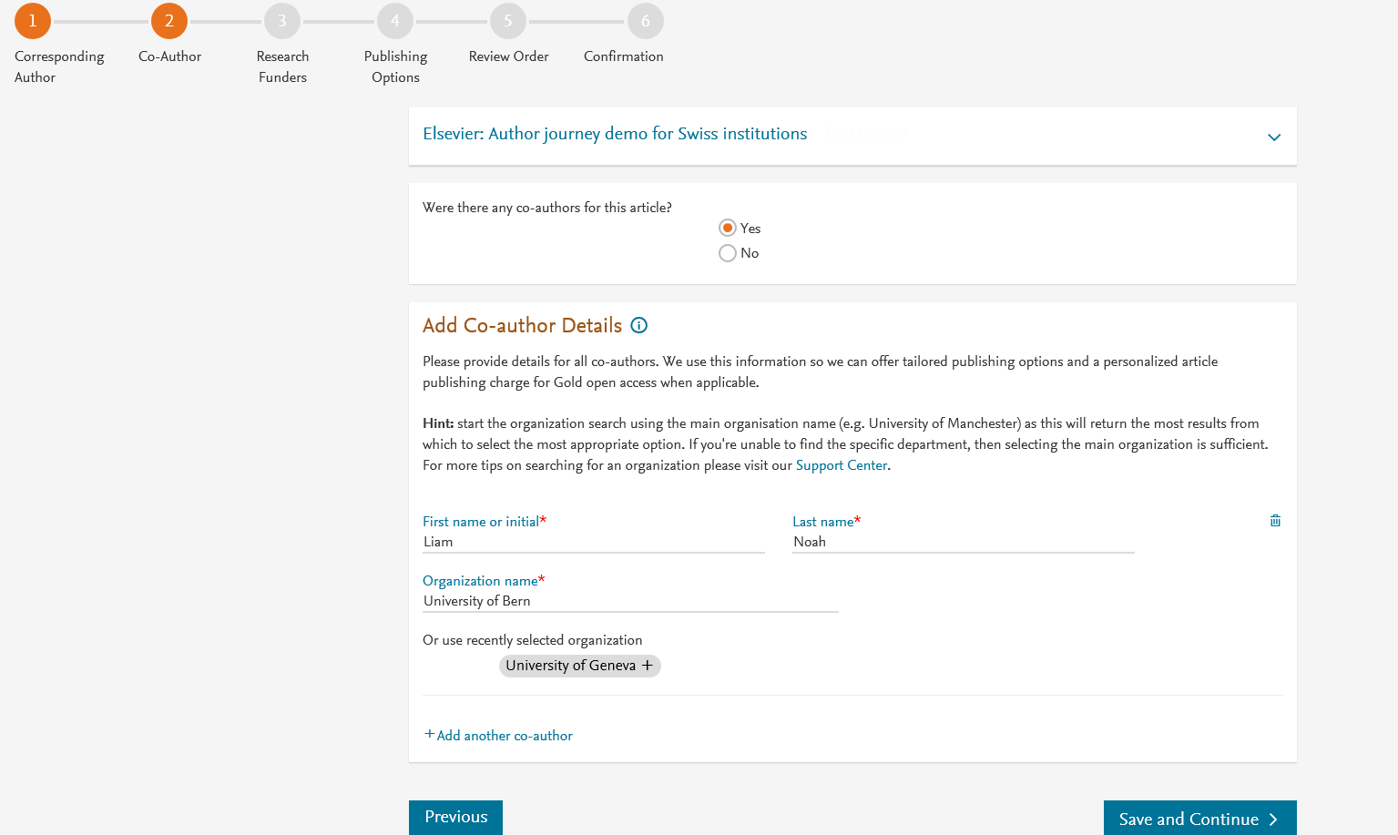
Corresponding author also adds the co-author affiliation details

Slide 7
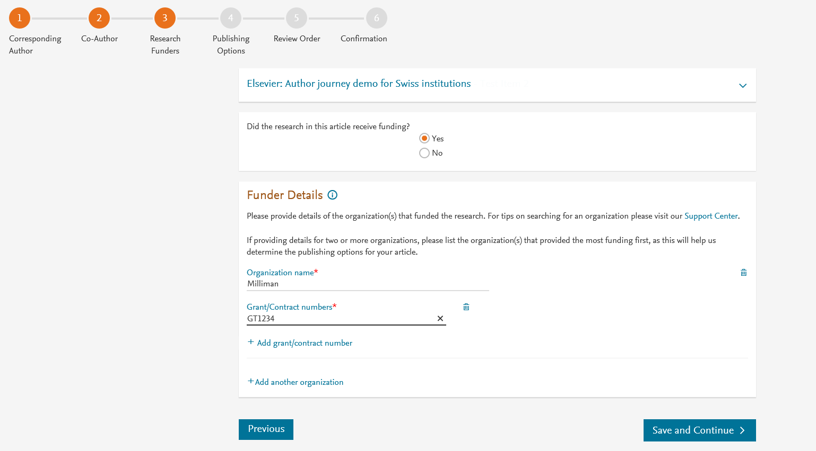
Author can add the Funder details. Funder can be the affiliated institute or a different one. In this case it is Milliman

Slide 8
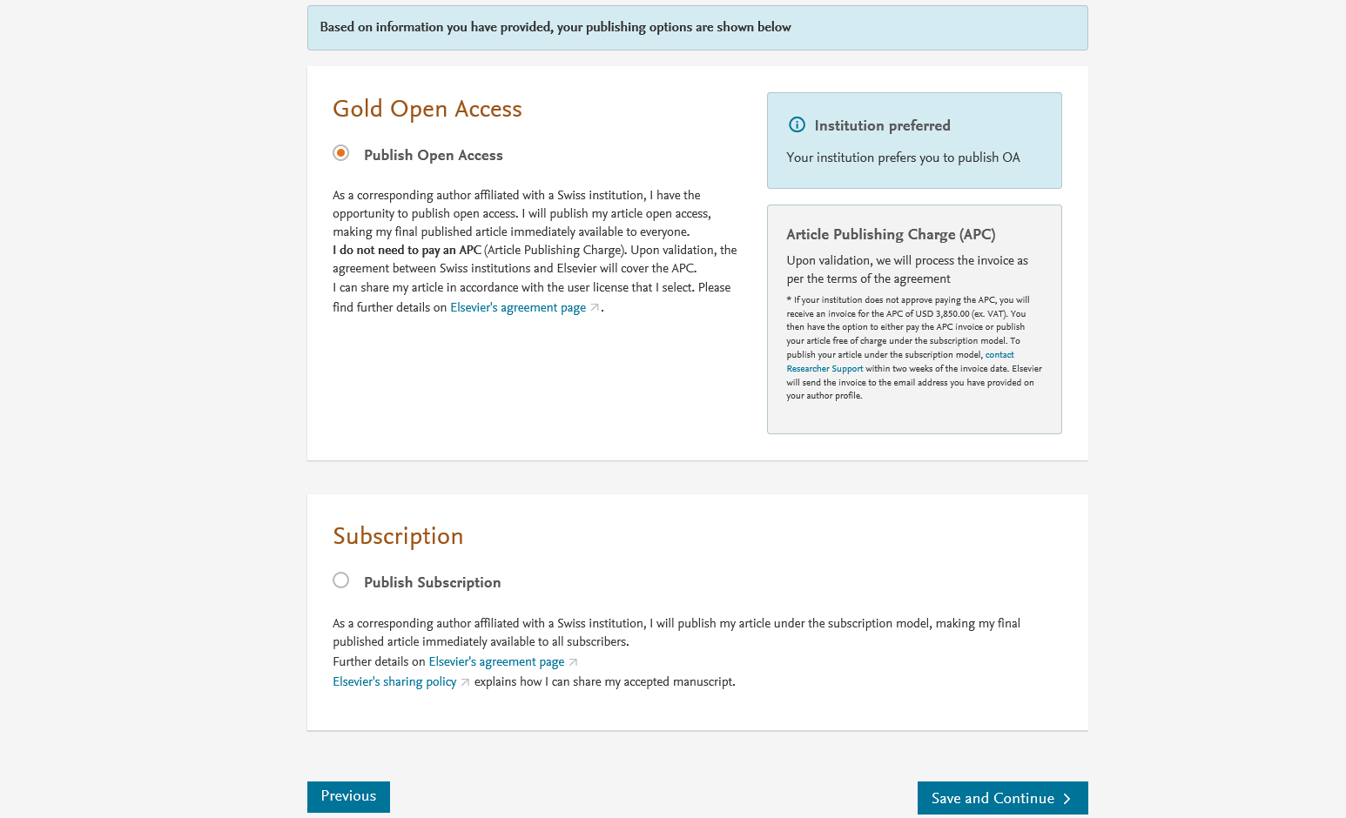
Based on the affiliation details, the author sees the Publishing Options. Gold OA option is followed by Subscription option and we make it clear that agreement covers full APC
If the librarian at the consortium rejects the author request in the Elsevier Platform, we also make it clear that the authors will receive a full price invoice
Author selects Gold OA

Slide 9
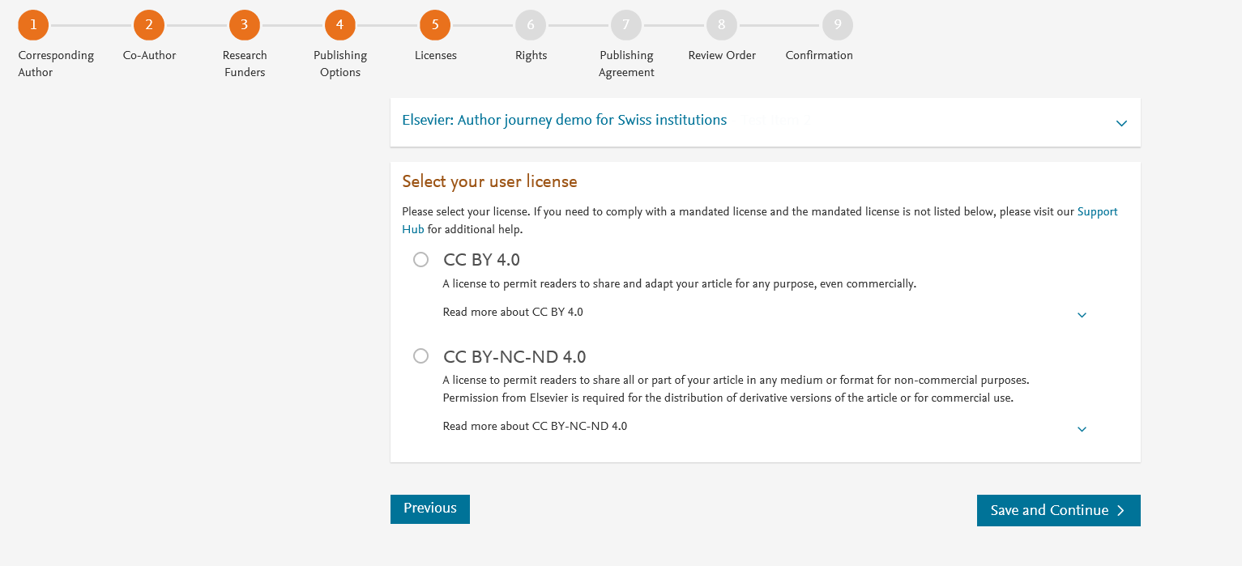
In case of OA, author selects the CC License
For Swiss agreement, we present CC BY followed by CC BY NC ND.
Author selects CC BY license in this case

Slide 10
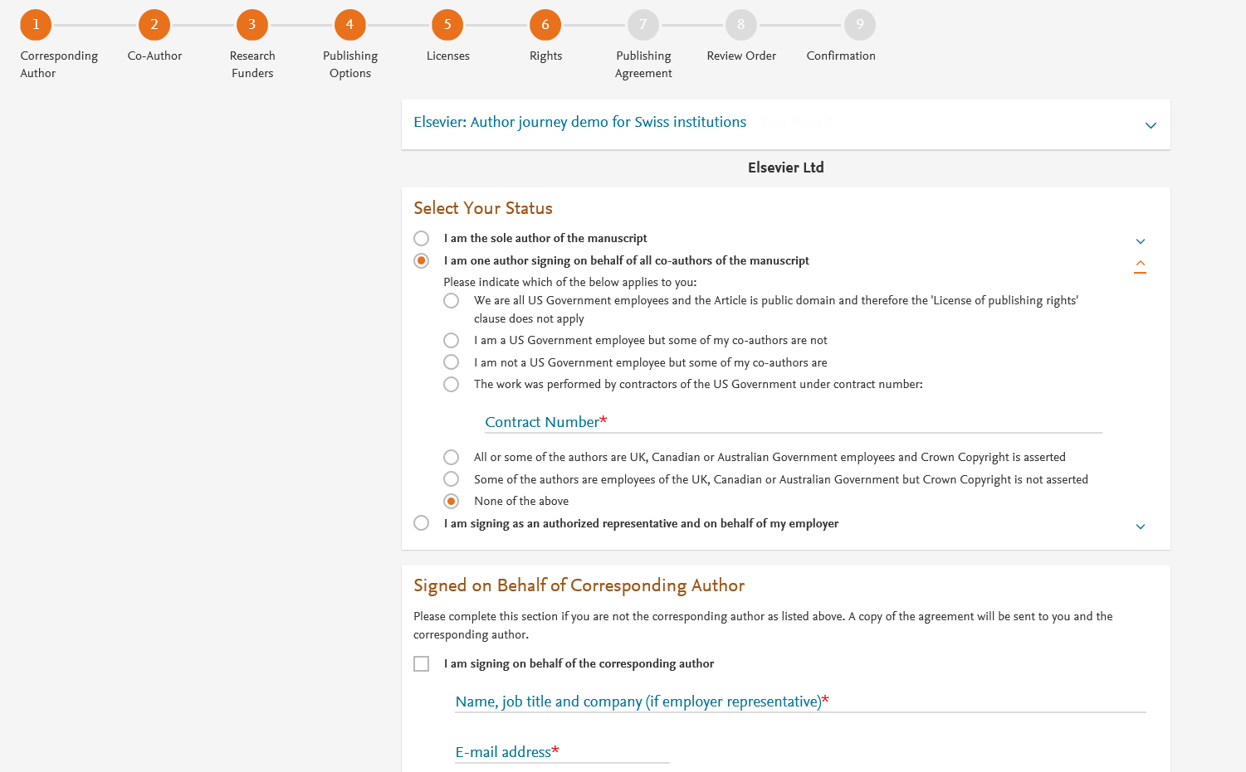
Author selects the rights

Slide 11
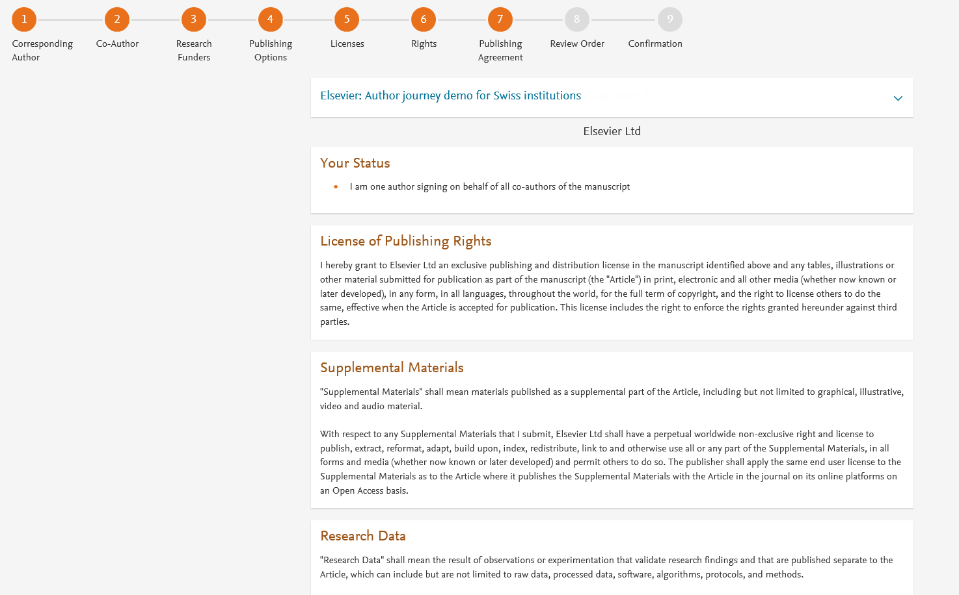
System presents author with the Journal License Publishing Agreement

Slide 12
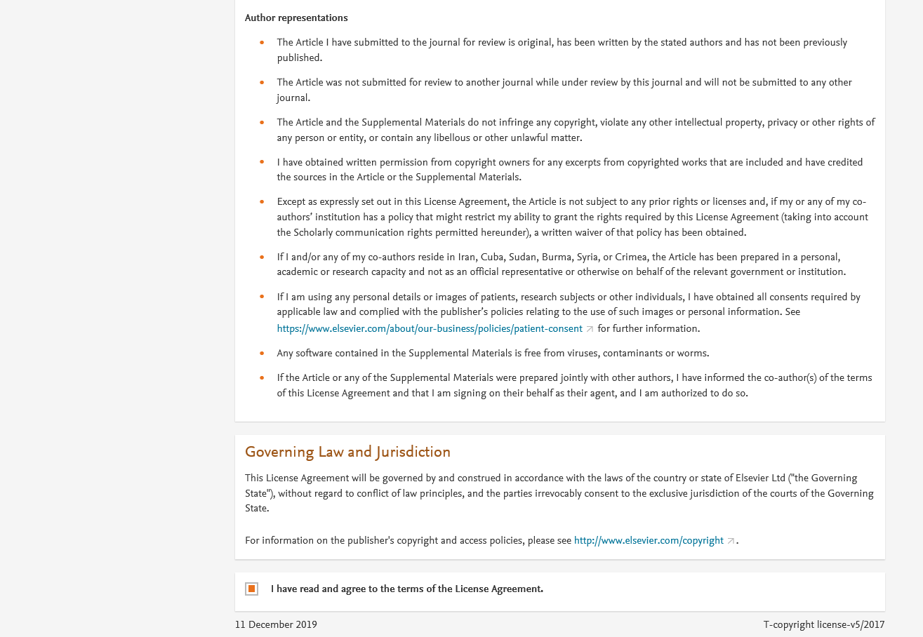
Authors agrees to the Journal License Publishing Agreement

Slide 13
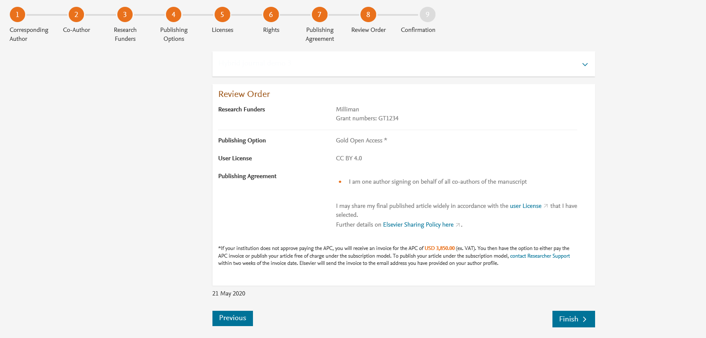
This is the summary page explaining the choices the author made in the publishing journey
Corresponding author and coauthors receive a copy of summary via email

